Slide 1
Event Storming

Slide 2
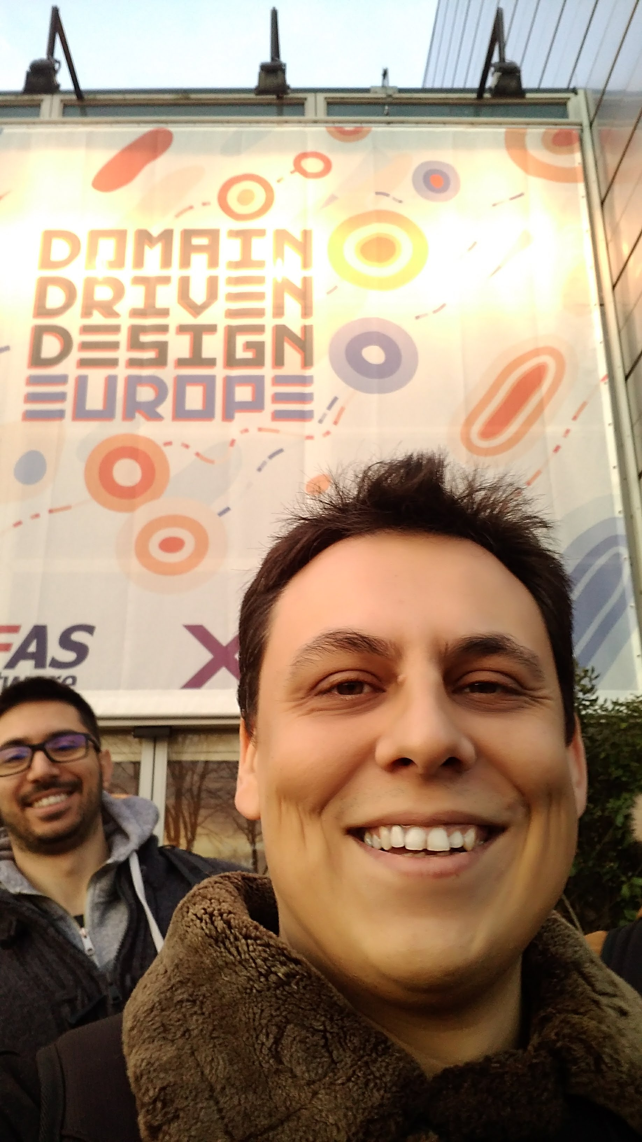
mynkow

Slide 3
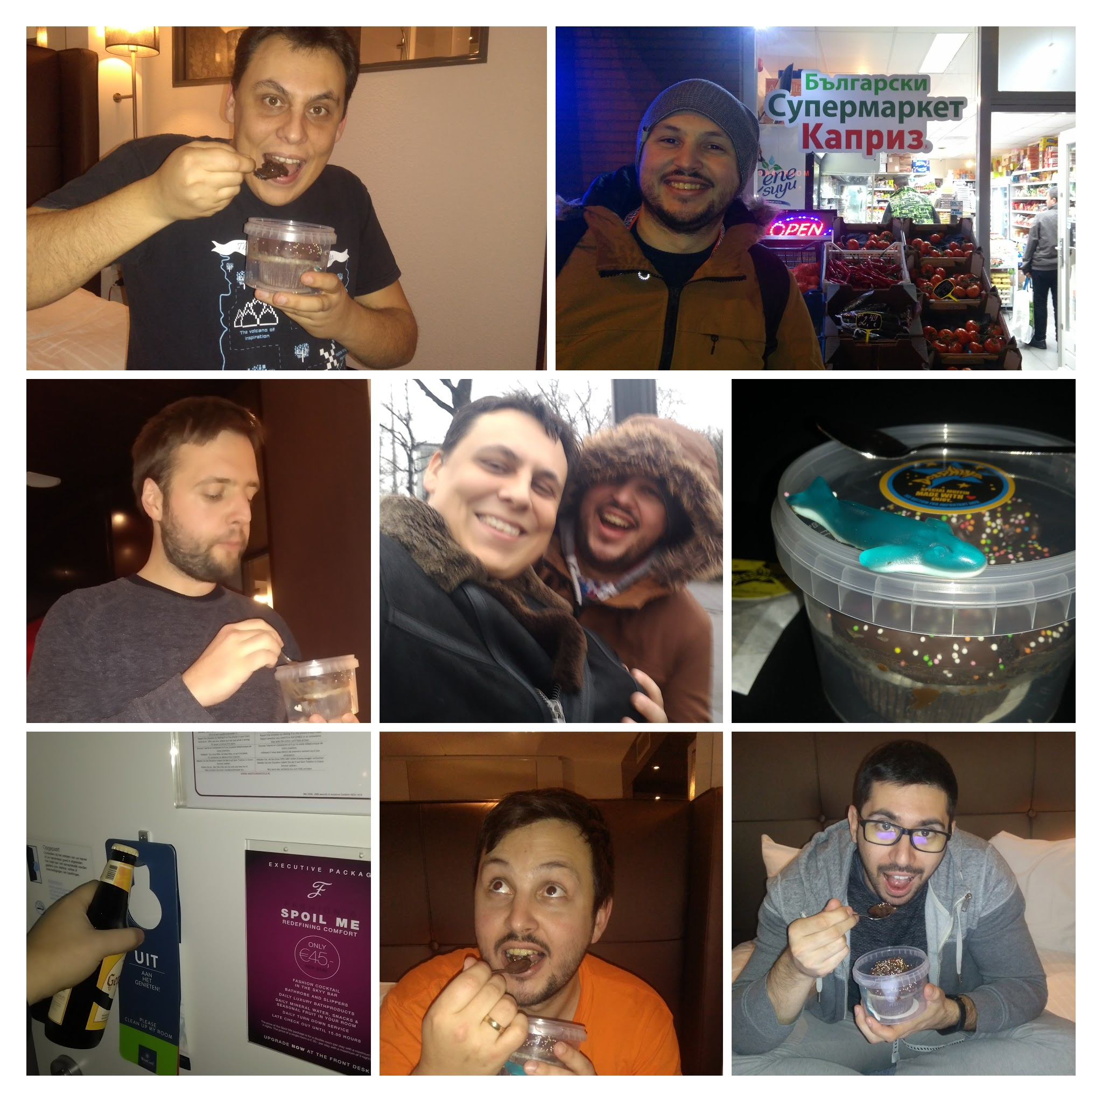

Slide 4
The Problem
Notes:
map

Slide 5
Setup
Invite the right people
Stickies + Markers
No chairs
Infinite working space !!!!!!!!!!!!!!!!!!!!!!!!!!!!!!!!!!!!!
Facilitator
Company departments
Set expectations
Explain what an Event is
Owners must know what they want

Slide 6
Conference Project
24 roles
Decision was made
Content management

Slide 7
The BIG picture
Notes:
In big picture the main goal is discovery: multiple perspectives and divergent thinking were allowed and encouraged through facilitator tricks.

Slide 8
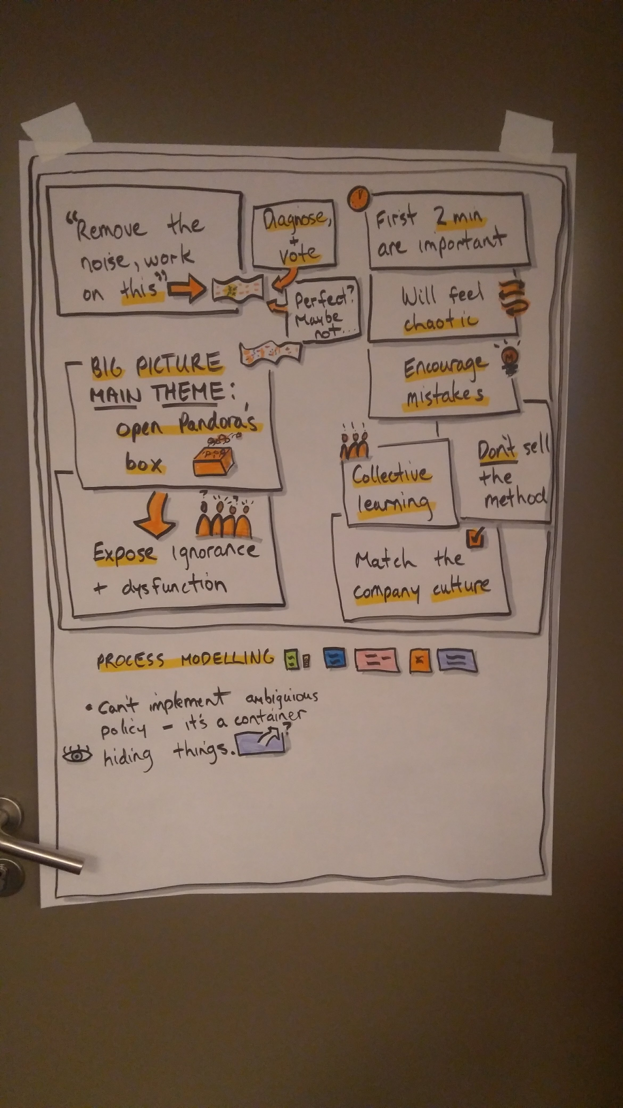
Chaos
Exploration
Match the company culture
Don’t sell the method
Will feel chaotic
Encourage mistakes
Spot overlaps

Slide 9
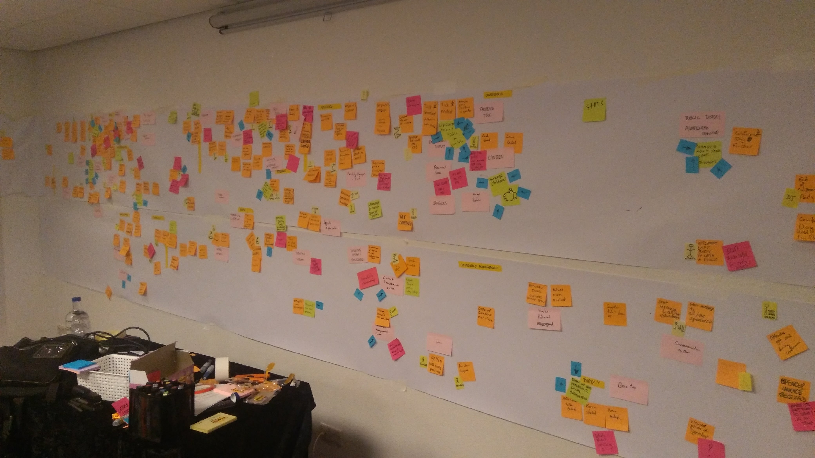

Slide 10
Ice Breaker
Cinderella

Slide 11
Organized Chaos
Incremental notation
Timeline enforcement
Remove duplication
Try to tell a story / Backwards as well
Watch for sidetracks and solve it with pink
Learn to smell bad legacy (spiderman)
Hotspots

Slide 12
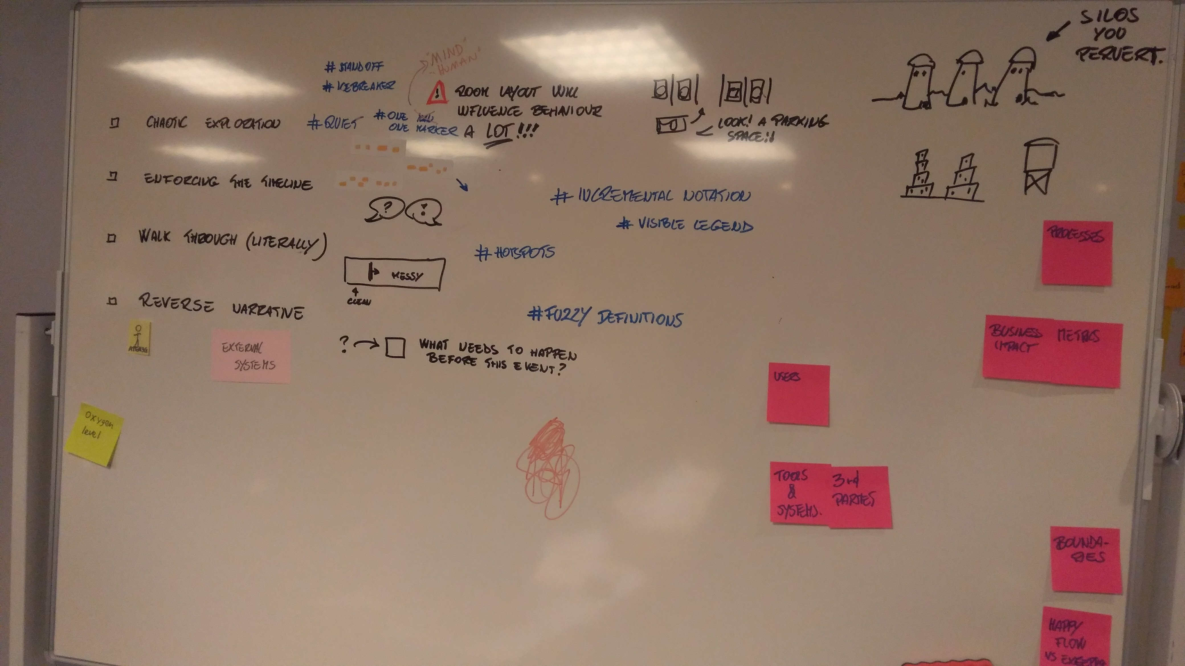

Slide 13
How to sort out things when the problem is hard?

Slide 14
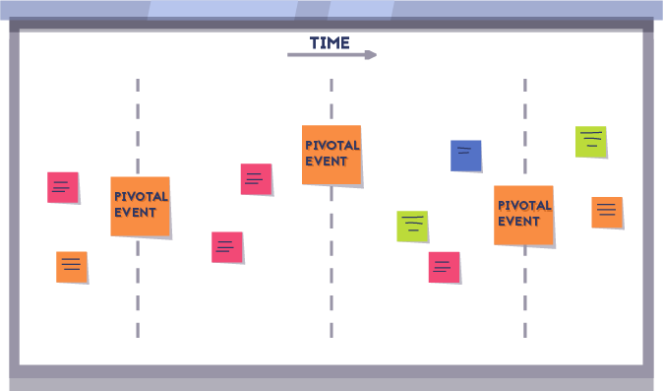
Pivotal Events

Slide 15
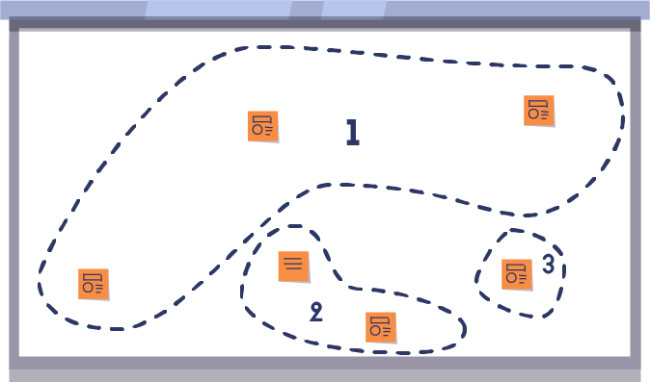
Chapters

Slide 16
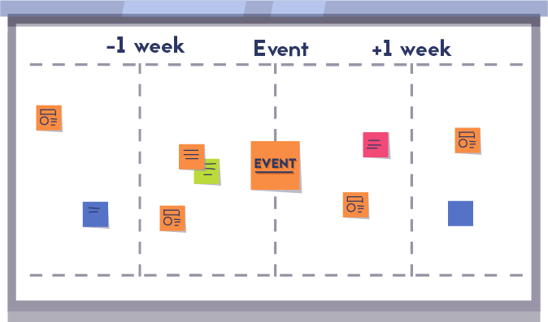
Time Frames

Slide 17
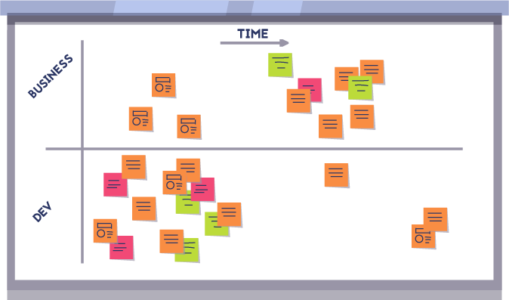
Iceberg

Slide 18
Add missing pieces
Place users
Talk about the money
Mark external systems
Give labels for groups of events (navigation)

Slide 19
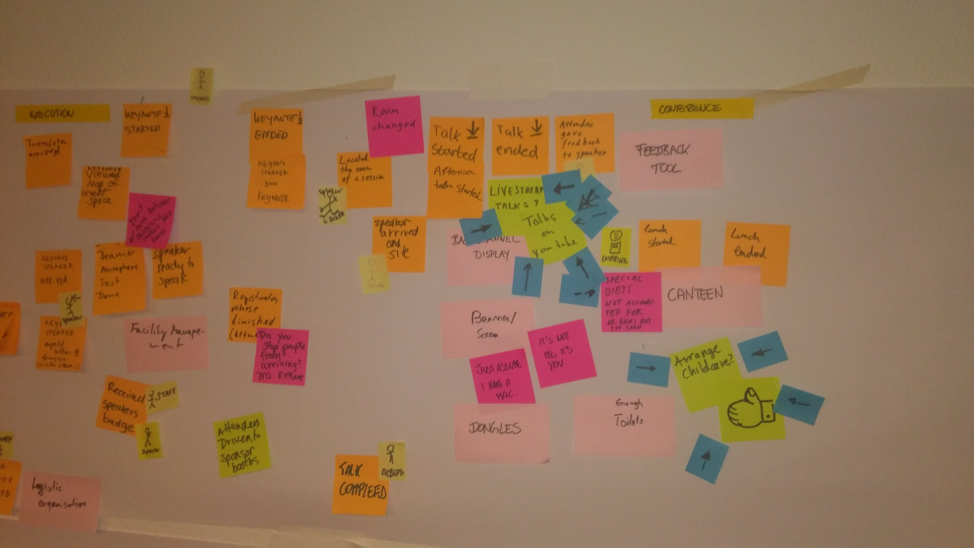
Notes:
2 arrows

Slide 20
Body Language
This is my area
Hmm, this is not completely true
Finger pointing
No communication / isolated people
Commentators
The invisible assistant

Slide 21
Business Process Modeling
Delivering value
The goal will be convergent, teams will have to agree on a given design
Make sure technical and non-technical shareholders are both satisfied

Slide 22
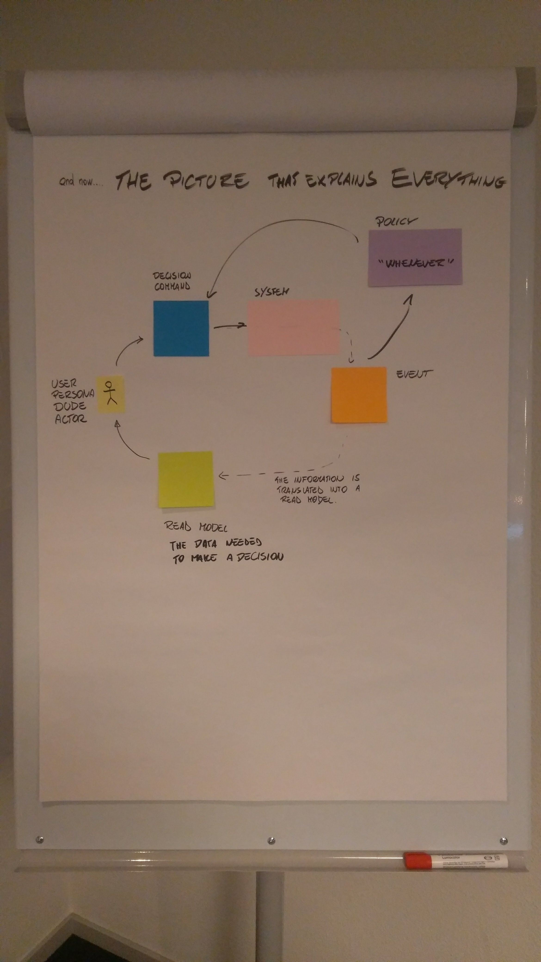
Notes:
2 arrows

Slide 23
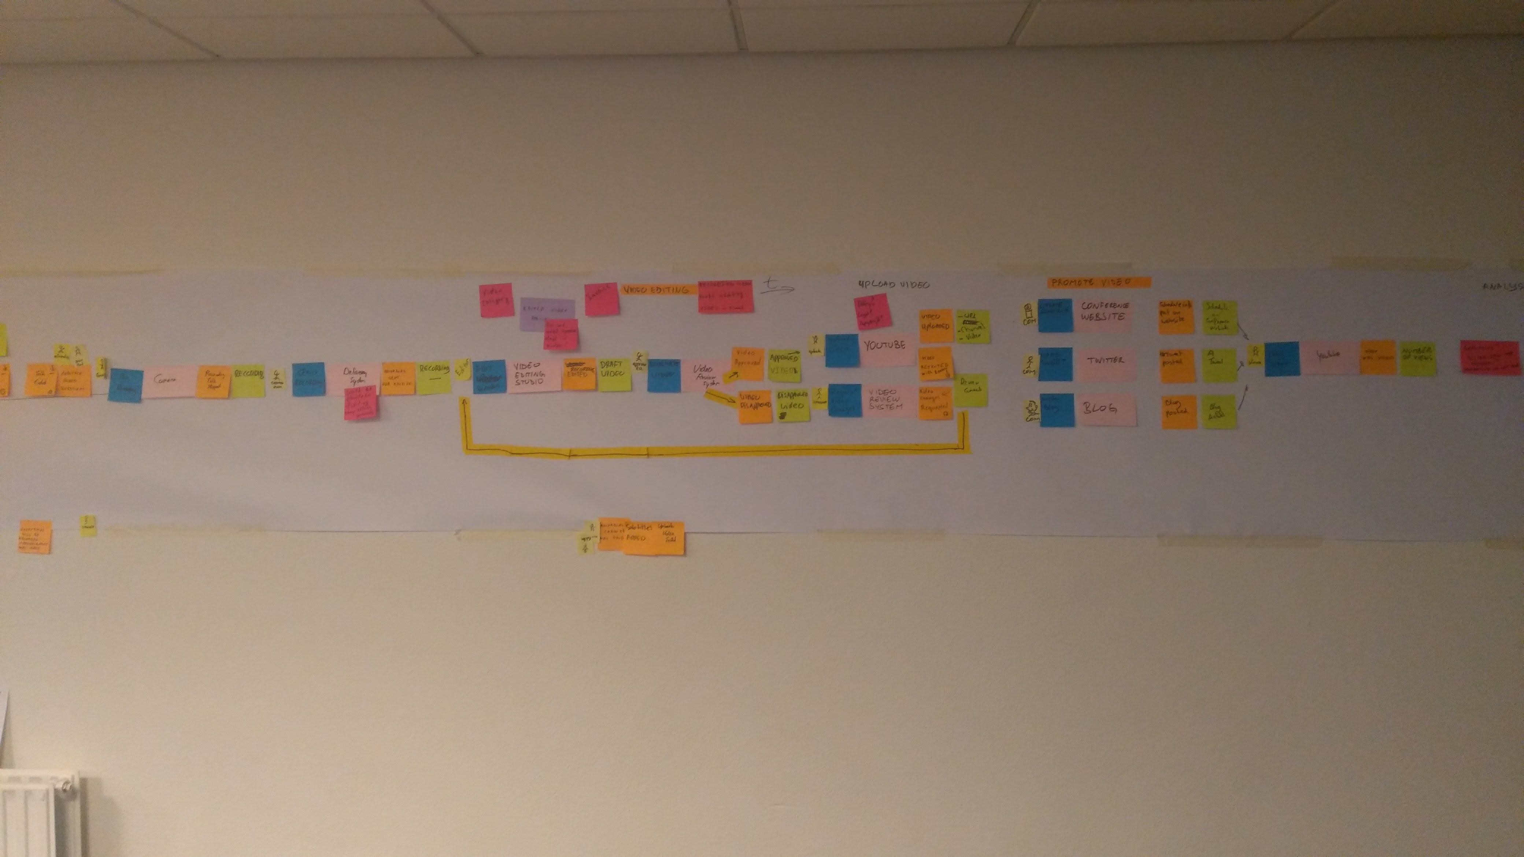
Notes:
2 arrows

Slide 24
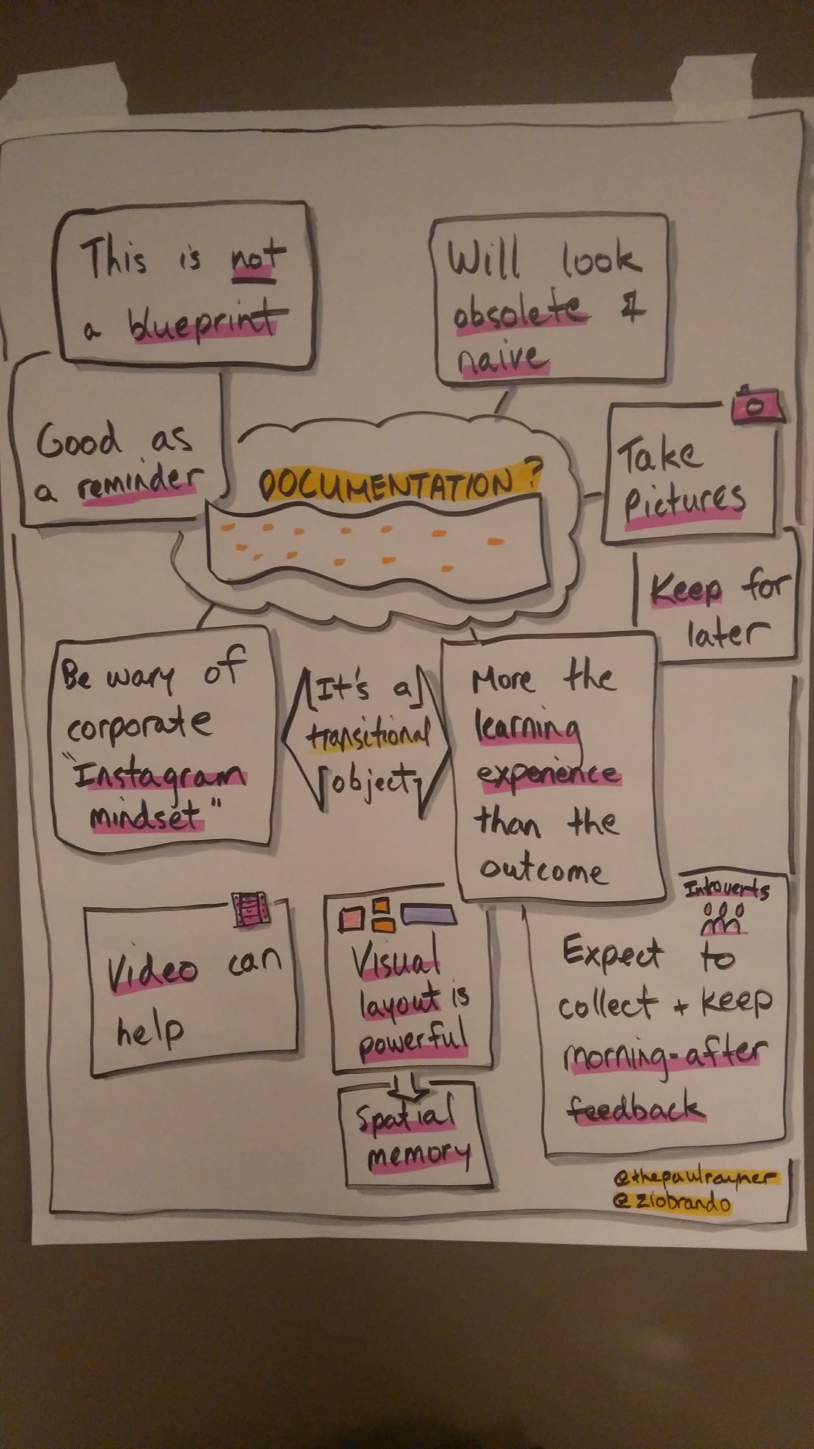

Slide 25
THANKS!
Any questions?

